Slide 1
The Effect of AI on Freelancing
Summary and Additional Analysis: Gene Olafsen

Slide 2
Refences
AI Is Taking Over These Freelancing Jobs the Most: Report | Entrepreneur
The jobs being replaced by AI - an analysis of 5M freelancing jobs - bloomberry
An Analysis of 5 Million Job Postings Showed These Are the 3 Jobs Being Replaced by AI the Fastest | Inc.com
Machines Won’t Steal Your Job | Anil Niraula (independent.org)
How Generative AI Adds Value to the Future of Work - Upwork
AI has Changed the Freelance Job Market — Here’s the Proof from Upwork | by Abe Bellini | Feb, 2024 | Medium

Slide 3
Upwork Overview and Dataset
Upwork is a 20+ year old company connects businesses with a global freelance talent pool.
Upwork Mission Statement:
"Our mission to create economic opportunities so people have better lives has taken us so much further. As a result, we’ve become the world’s work marketplace where every day businesses of all sizes and independent talent from around the globe meet here to accomplish incredible things."
This analysis considers Upwork data from November 1, 2022, to February 14, 2024.

Slide 4
Job Categories with Notable Decline
Writing, translation, and customer service jobs, experienced notable declines, with decreases of 33%, 19%, and 16%, respectively.
This should not come as a shock, as some of the earliest and most developed use cases for AI are basic copywriting tasks and customer service chatbots.
Swedish buy-now-pay-later startup Klarna recently announced that its customer service chatbot is doing the work of 700 customer service reps.
The media has been full of stories of writers who have lost their jobs to AI.

Slide 5
Job Categories Increasing
Video editing/production jobs saw a 39% increase, graphic design jobs increased by 8%, and web design jobs saw a 10% uptick since ChatGPT release.
Generative AI tools could be good enough now to replace writing tasks, but not yet up to par for quality results in tasks like generating images or videos. However, that could change as OpenAI recently announced its Sora text-to-video AI generator.
Another explanation for the increase could be that users do not yet understand how to fully use AI tools.
Note: AI-enhanced image and video tools/services are evolving quickly.

Slide 6
Borrowing Models?
No substantial growth in data annotation or machine learning jobs was observed, suggesting limited focus on training or refining models by companies.

Slide 7
Translation and Annotation
Translation jobs suffered the most significant decline in hourly pay, with a drop of over 20%, while graphic design and web design jobs remained resilient, experiencing an increase in both volume and hourly pay.
Despite initial assumptions, data annotation jobs remained relatively flat, and machine learning jobs slightly decreased post-ChatGPT release.

Slide 8
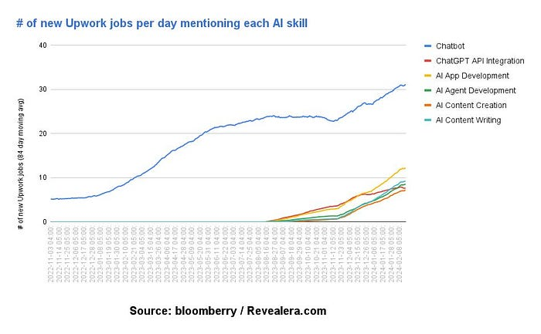
Upwork Resources Embrace AI
A 2023 Upwork survey showed that freelancers make up 38% of the U.S. workforce and that they are 2.2 times more likely to regularly use generative AI than other professionals for tasks like research, brainstorming, and coding.

Slide 9
AI Job Postings
AI-related job postings indicate an increasing demand for roles such as developing AI content, AI agents, integrating OpenAI/ChatGPT APIs, and AI apps.
The standout use case for AI is the development of chatbots, with a substantial 2000% surge in related job postings since ChatGPT release.
A majority of companies appear focused on integrating OpenAI’s API and developing chatbots rather than fine-tuning their own language models.

Slide 10
Summary
The data raises questions about the proficiency of AI tools for specific use cases and the learning curve for effective utilization.

